Slide 1
Exploring models for Cardiovascular Disease

Slide 2
The data - what were we collecting and how was it cleaned?
Original dataset consisted of 70,000 patients, with data regarding their respective age, height, weight, gender, blood pressures, cholesterol levels, glucose, smoking, alcohol intake, physical activity, and of course the presence of cardiovascular disease
We cleaned the data by delete wrong data (systolic blood pressure lower than diastolic blood pressure), and unreasonable data (extreme weight , height, diastolic and systolic blood pressure values)

Slide 3
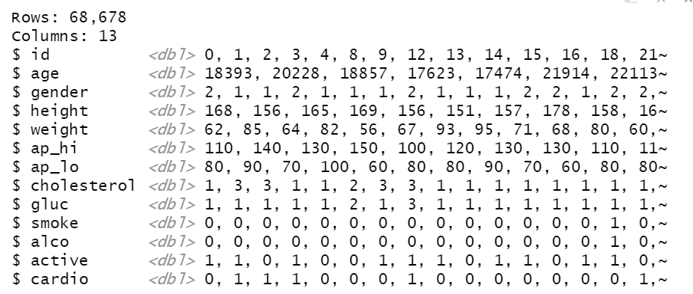
Cleaned data set preview

Slide 4
More on the independent variables…
Presence of Cardiovascular Disease: 0 - No, 1 - Yes
Age: days
Height: centimeters (cm.)
Weight: kilograms (kg.)
Blood Pressure: millimeters of mercury (mm Hg)
Systolic (ap_hi) / diastolic (ap_lo) blood pressure
Gender: 0 - female, 1 - male
Cholesterol: 1 - Normal, 2 - Above normal, 3 - Well above normal
Glucose: 1 - Normal, 2 - Above normal, 3 - Well above normal
Smoke: 0 - patient doesn’t smoke, 1 - patient smokes
Alcohol Intake: 0 - patient doesn’t drink, 1 - patient drinks
Physical Activity: 0 - patient is not active, 1 - patient is active

Slide 5
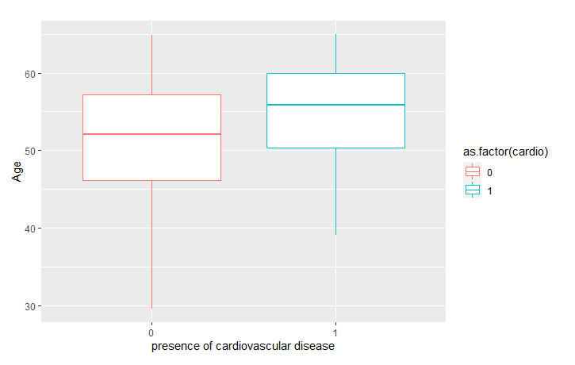
Presence of Cardiovascular Disease based on Age of the Patient
Relationship!

Slide 6
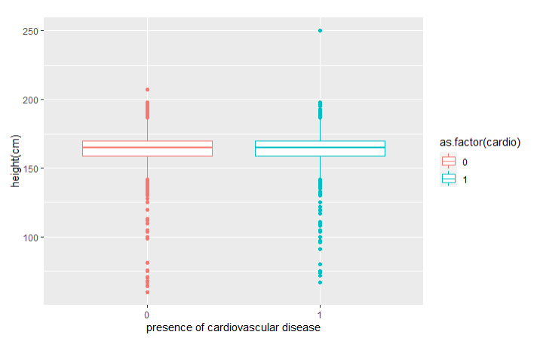
Presence of Cardiovascular Disease based on Height of the Patient
No
Relationship

Slide 7
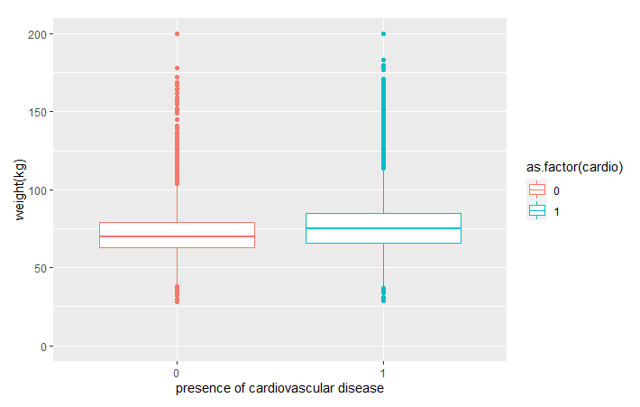
Presence of Cardiovascular Disease based on Weight of the Patient
Unsure of a Relationship

Slide 8
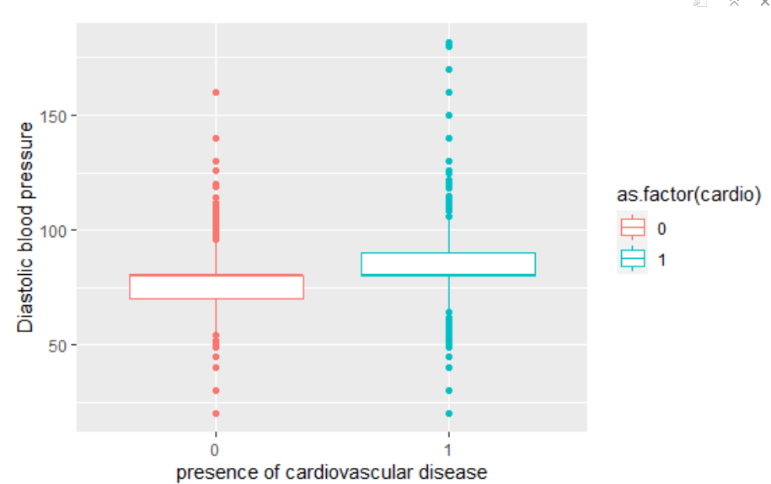
Presence of Cardiovascular Disease based on Diastolic Blood Pressure of the Patient
Relationship!

Slide 9
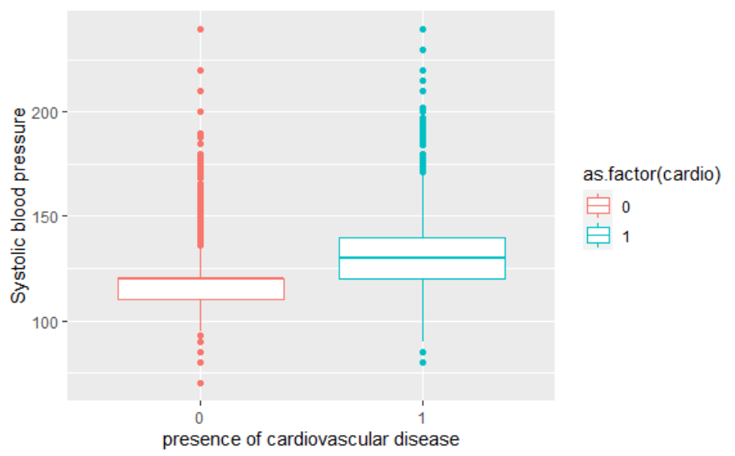
Presence of Cardiovascular Disease based on Systolic Blood Pressure of the Patient
Relationship!

Slide 10
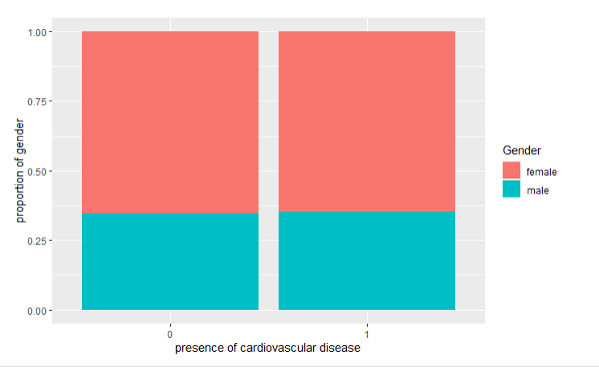
Presence of Cardiovascular Disease based on the Patient’s Gender
No
Relationship

Slide 11
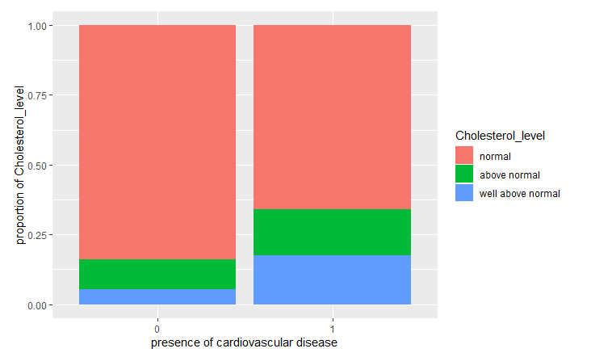
Presence of Cardiovascular Disease based on the Patient’s Cholesterol Level
Relationship!

Slide 12
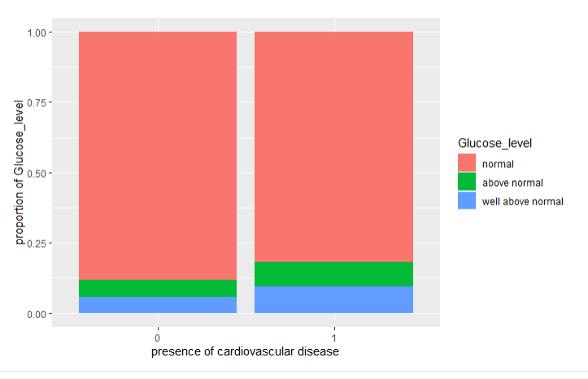
Presence of Cardiovascular Disease based on the Patient’s Glucose Level
Relationship!

Slide 13
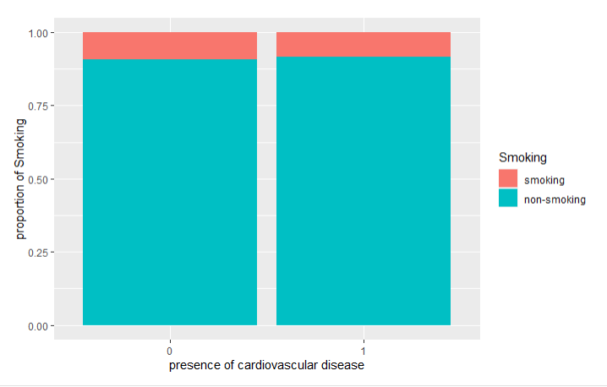
Presence of Cardiovascular Disease based on the Patient’s Smoking (or lack thereof)
Unsure of a Relationship

Slide 14
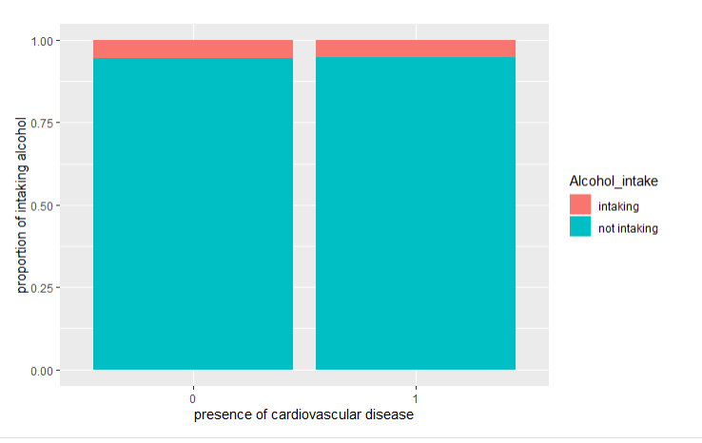
Presence of Cardiovascular Disease based on the Patient’s Alcohol Intake (or lack thereof)
No
Relationship

Slide 15
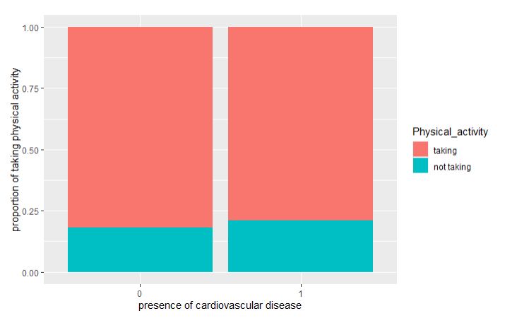
Presence of Cardiovascular Disease based on the Patient’s Physical Activity (or lack thereof)
Unsure of a Relationship

Slide 16
What the graphs told us…
The apparent influences of cardiovascular disease are:
Age
Cholesterol Level
Glucose Level
Diastolic Blood Pressure
Systolic Blood Pressure
The perhaps less obvious influences are:
Weight
Smoking
Physical Activity
Let’s explore models with at least the first 5 variables, and then see if the last 3 are also useful to add!

Slide 17
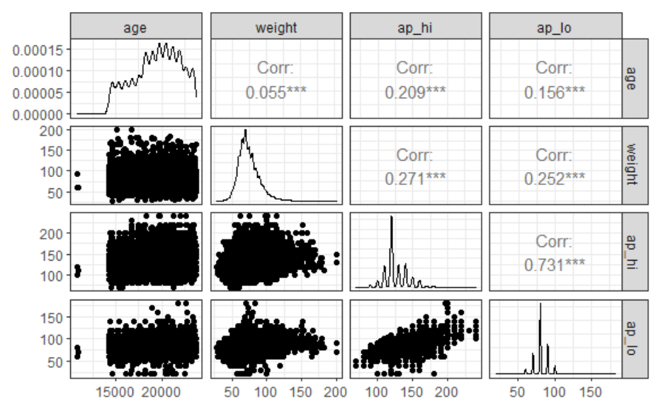
Relationship between Pairs of Variables

Slide 18
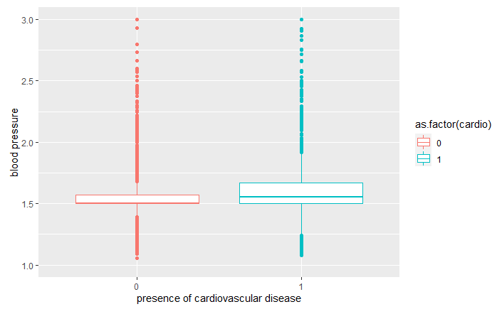
Presence of Cardiovascular Disease based on Blood Pressure of the Patient
Relationship!

Slide 19
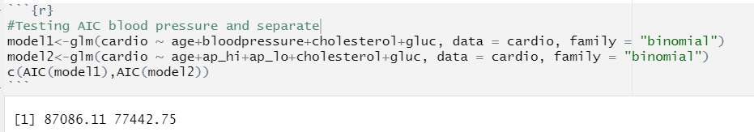
Before doing so…
This begs the question: should we have simply kept them separate?
AIC w/ singular blood pressure:
87,086.11
AIC w/ blood pressure separate:
77,442.75
Winner!

Slide 20
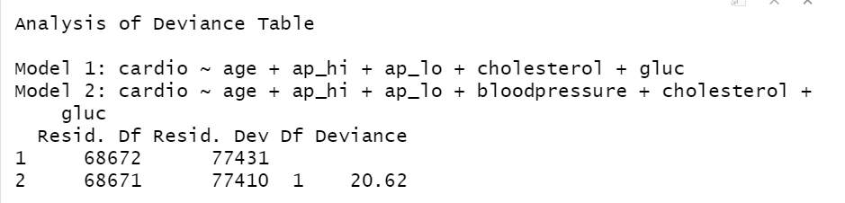
Testing whether interaction needed
We can simply use systolic and diastolic blood pressure !

Slide 21
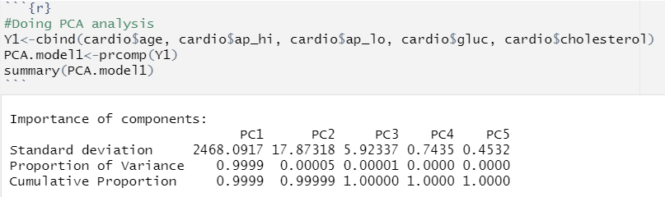
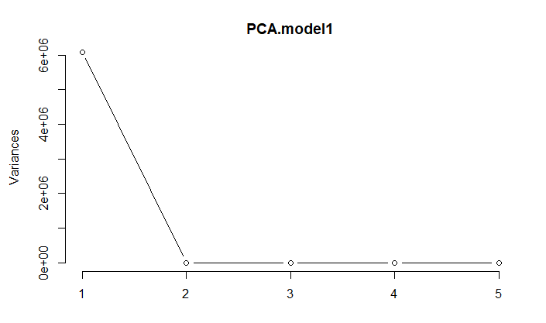
Does PCA help? (accounting for only Age, Blood Pressure, Glucose, and Cholesterol)
PCA1 captures 99.99% of the variance!

Slide 22
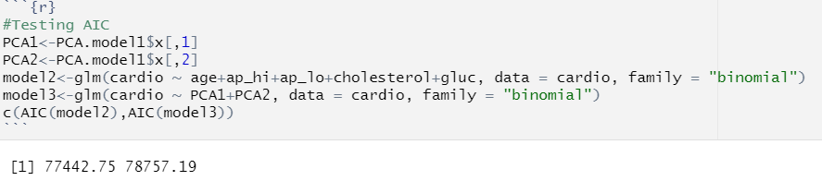
Does PCA help? (cont.)
AIC w/ using PCA:
78,757.19
AIC w/o using PCA:
77,442.75

Slide 23
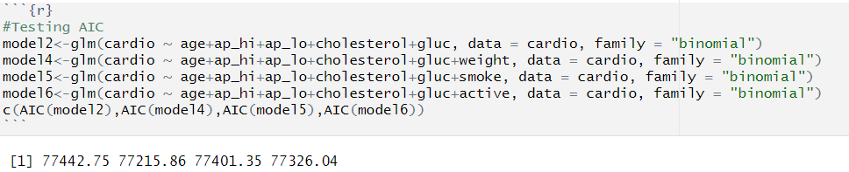
Now with separate blood pressures, let’s test out Weight, Smoking, and Physical Activity
AIC w/ none of the three:
77,442.75
AIC w/ Weight added:
77,215.86
AIC w/ Smoking added:
77,401.35
AIC w/ Physical Activity added:
77,326.04

Slide 24
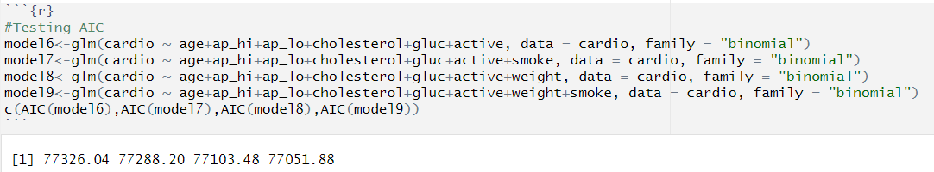
How does the model perform with Weight, Smoking and Physical Activity added all together?
AIC w/ just Physical Activity added:
77,326.04
AIC w/ Physical Activity and Smoking added:
77,288.20
AIC w/ just Physical Activity and Weight added:
77,103.48
AIC w/ all three added:
77,051.88

Slide 25
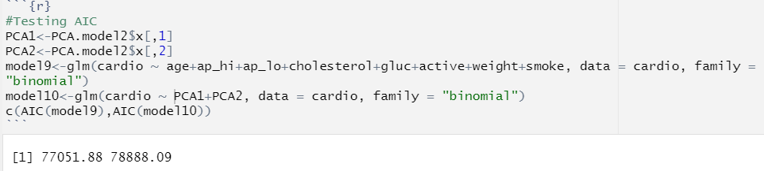
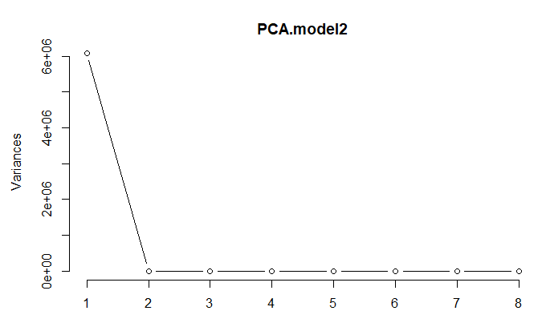
Does PCA help when using the better model? (Weight, Smoking, and Physical Activity added)

Slide 26
Does PCA help? (cont.)
AIC w/ using PCA:
78,888.09
AIC w/o using PCA:
77,051.88

Slide 27
Application
Using data to prove that age, glucose level, cholesterol level, diastolic blood pressure, and systolic blood pressure have relationship with cardiovascular disease; weight, physical activity, and smoking may affect cardiovascular disease; gender, alcohol intaking, and height have no relationship with cardiovascular disease.
Use model to predict whether a potential patient is likely to get cardiovascular disease.

